Slide 1
Scripting for Network Professionals
National Convergence Technology Center
Working Connections Five Fridays
February 3, 2023
Professors Pamela Brauda & David Singletary
Florida State College at Jacksonville

Slide 2
Hands-on Labs
Day 1

Slide 3
Write a program that calculates the area of a rectangle
create and initialize variables to store the length and width (initialize means to set an initial value, always a good programming practice). What type should these variables be?
create and initialize a variable to store the area (what type?) (area = length * width)
print area variable

Slide 4
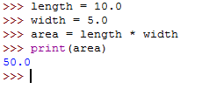
Area Calculator

Slide 5
Write a program that calculates miles per gallon, given mile driven and gallons used
miles per gallon = miles driven / gallons used
round the result to 2 places

Slide 6
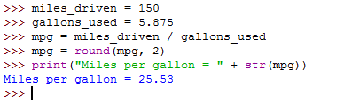
Miles Per Gallon Program
"Quick" version: enter necessary code for interpreter using IDLE

Slide 7
Basic Arithmetic Lab
# !/usr/bin/env python3
# YourName
# DoTheMath.py
# M1 Practice Exercise 1
# Get two numbers from the user
# Use the numbers in basic arithmetic operations
# Display the output to the user
# Prompt the user for a float value
# Prompt the user for another float value
# Display the sum of the two values
# Display the product of the two values
# Display the quotient of the two values

Slide 8
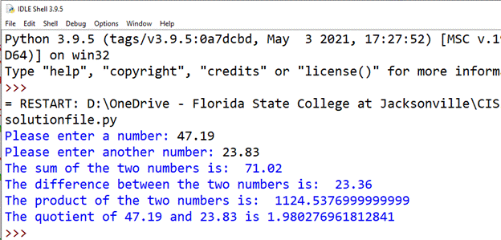
Expected output

Slide 9
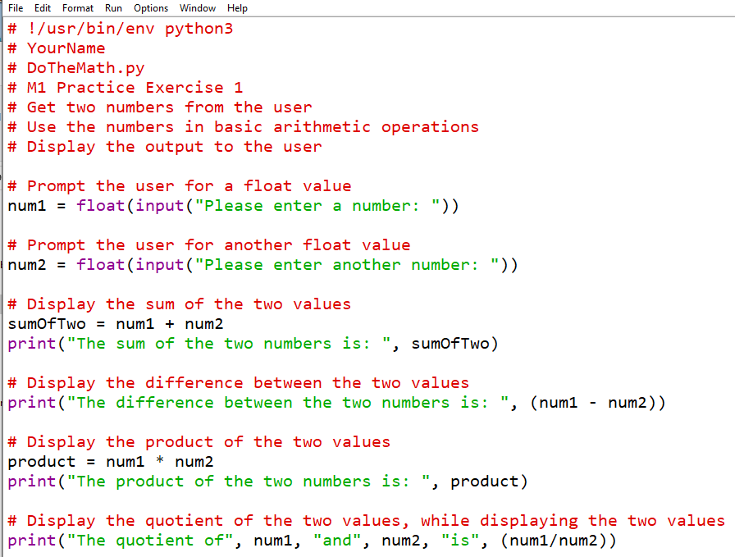

Slide 10
Programming Assignment
Instructions
Design a Python program which prompts the user for the number of IT majors and the number of non-IT majors registered in a course.
Display the values as a percentage of the total number of students in the class.
Round all displayed percentages to 1 place.
Use an "end" to append a percentage sign to your percentage values (be sure to multiply the calculated percentage by 100).
Submission
Upload your .py source code file and a screenshot showing your output from execution. Be sure your code conforms to the course programming assignment rubric, including the use of a shebang line and an ID header at the top of your file.

Slide 11
Programming Assignment
Expected output (user input shown in red):
Test Run #1:
Please enter the total number of IT majors in the course: 6 Please enter the total number of non-IT majors in the course: 13 The percentage of IT majors is 31.6% The percentage of non-IT majors is 68.4%
Test Run #2:
Please enter the total number of IT majors in the course: 5 Please enter the total number of non-IT majors in the course: 15 The percentage of IT majors is 25.0% The percentage of non-IT majors is 75.0%

Slide 12
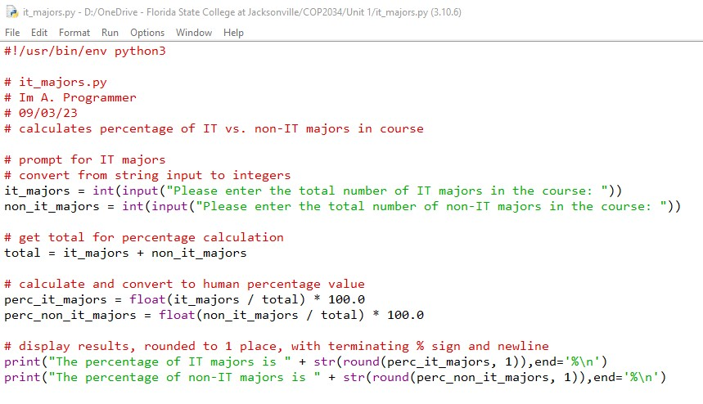
Programming Assignment Solution

Slide 13
Write a program which uses an if statement that asks the user for a number of sides (up to 5) and identifies the shape associated with that number. Use elif and else as necessary.
Sides | Shape
0 | error
1 | line
2 | polyline
3 | triangle
4 | rectangle (could also be a square)
5 | pentagon
> 5 | error

Slide 14
#!/usr/bin/env python3
# shapes.py
# prompt user for sides and display corresponding shape
# get user input and convert to an integer
sides = input("Please enter a number of sides from 1 to 5: ")
sides = int(sides)
# print the shape associated with that number of sides
# or print an error if the number is out of range
if sides == 1:
print("1 side is a line")
elif sides == 2:
print("2 sides is a polyline")
elif sides == 3:
print("3 sides is a triangle")
elif sides == 4:
print("4 sides is a rectangle - and maybe a square")
elif sides == 5:
print("5 sides is a pentagon")
else:
print("that number is out of my range")

Slide 15
Nested If-elif-else Lab
Write a program that does the following:
Displays a numeric menu for ice cream flavor choices (vanilla, chocolate, strawberry).
Validate the user's menu choice.
If the selection is vanilla, prompt the user to confirm if they really want vanilla.
Expected output:
========= RESTART: C:/Users/pbrauda/Documents/M2pe.py ================= 1. vanilla 2. chocolate 3. strawberry Please select an item from the above choices: 1 you chose vanilla Are you sure? y/n: y OK! Here comes the ice cream!

Slide 16
================== RESTART: C:/Users/pbrauda/Documents/M2pe.py 1. vanilla 2. chocolate 3. strawberry Please select an item from the above choices: 2 you chose chocolate ================== RESTART: C:/Users/pbrauda/Documents/M2pe.py 1. vanilla 2. chocolate 3. strawberry Please select an item from the above choices: 3 you chose strawberry ================== RESTART: C:/Users/pbrauda/Documents/M2pe.py 1. vanilla 2. chocolate 3. strawberry Please select an item from the above choices: 0 invalid choice ================== RESTART: C:/Users/pbrauda/Documents/M2pe.py 1. vanilla 2. chocolate 3. strawberry Please select an item from the above choices: 9 invalid choice

Slide 17
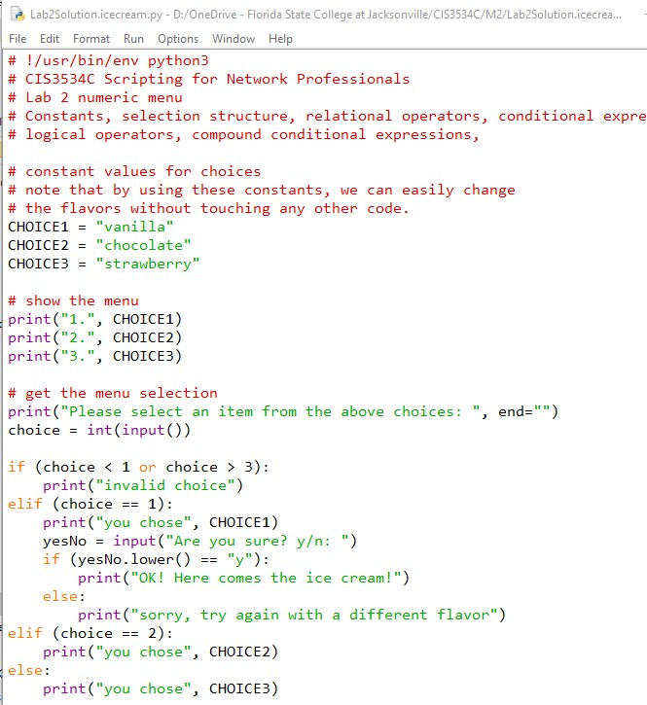

Slide 18
Programming Assignment
Design an application in Python which registers students for a course. There are three courses available which must be taken sequentially. Display a numeric menu which allows the student to choose one of the three courses.
The first course has no prerequisites so students can be enrolled immediately.
Before enrolling a student in the second course, the program must check if they have taken the first course as a prerequisite.
Before enrolling a student in the third course, the program must check if they have taken the first two course as prerequisites.
Your application must validate the menu input, do not allow selections below the minimum course number or above the maximum.
Design your application so that a course sequence can be easily swapped out for a different sequence (I used a sequence of Python courses but this can be changed by changing 4 lines of code).
Be sure to indent your code correctly, include an ID header, use meaningful variable names, use constants where appropriate, and include descriptive comments.

Slide 19
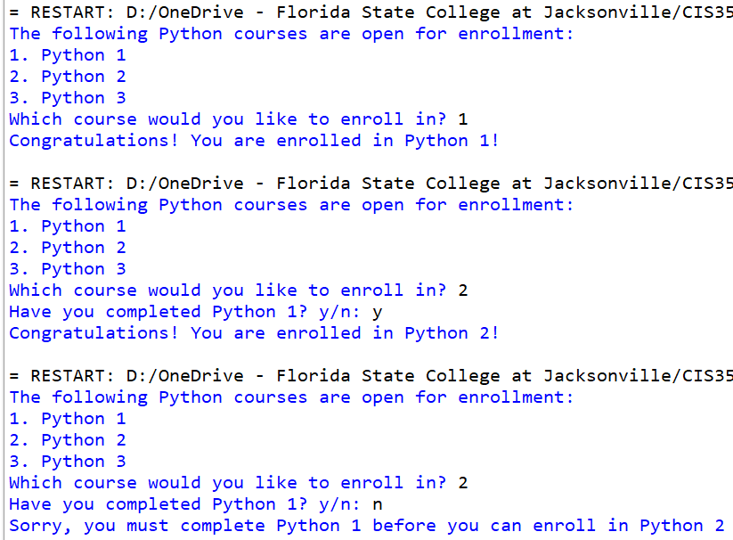
Expected output:

Slide 20
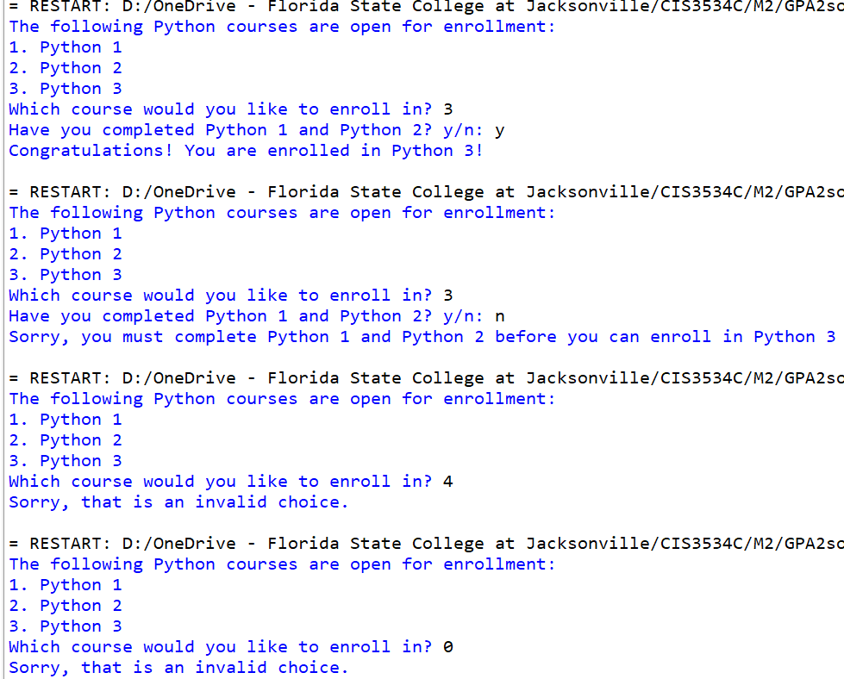
Expected output:

Slide 21
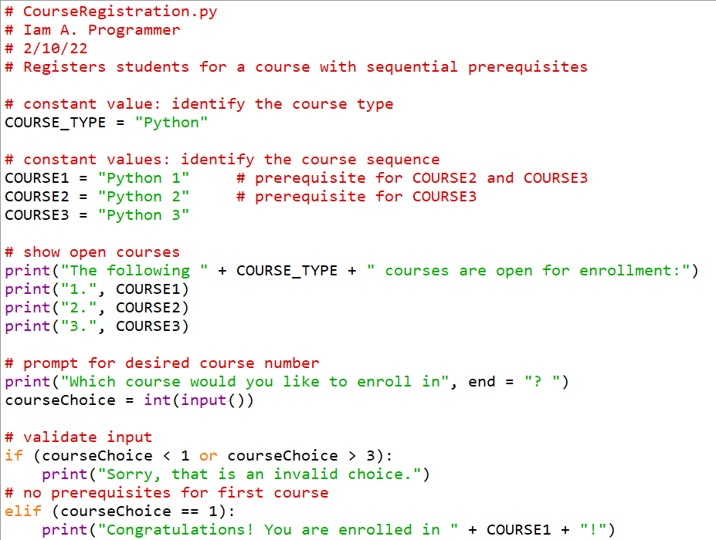
Programming Assignment Solution cont.

Slide 22
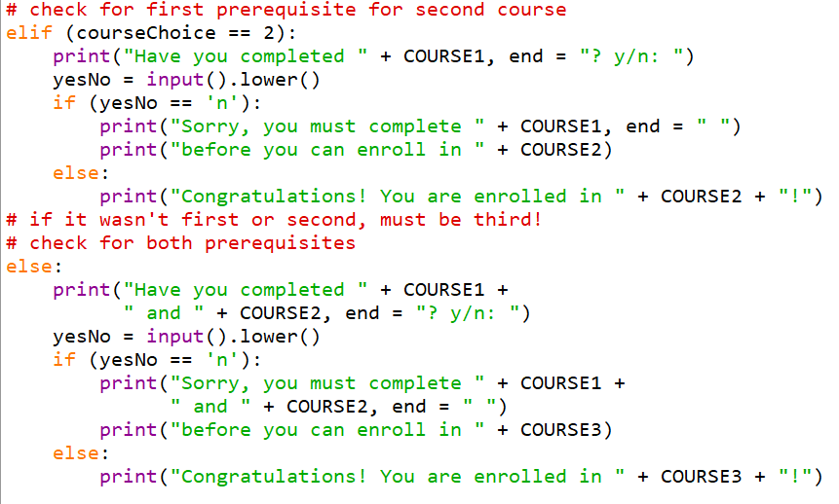
Programming Assignment Solution

Slide 23
Case Study: Calculate Future Value
Write a program which prompts the user for a monthly investment amount, a yearly interest rate, and a number of years; then calculate the future value of the investments using a monthly interest calculation
The program should loop with a prompt to the user for new input until they choose to exit (this should be your outer loop)

Slide 24
Pseudocode for Future Value Program
Display user message
While user wants to continue
Input monthly investment, yearly interest rate, and years
Convert yearly interest rate to monthly interest rate
Convert years to months
Set future value = 0
For each month
Add monthly investment amount to future value
Calculate interest for month
Add interest to future value
Display future value
Ask if user wants to continue
Display end message

Slide 25
The Future Value Program
print("Welcome to the Future Value Calculator")
print()
choice = "y"
while choice.lower() == "y":
# get input from the user
monthly_investment = float(input("Enter monthly investment:\t"))
yearly_interest_rate =
float(input("Enter yearly interest rate:\t"))
years = int(input("Enter number of years:\t\t"))

Slide 26
# convert yearly values to monthly values
monthly_interest_rate = yearly_interest_rate / 12 / 100
months = years * 12
# calculate the future value
future_value = 0
for i in range(months):
future_value += monthly_investment
monthly_interest_amount = future_value * monthly_interest_rate
future_value += monthly_interest_amount
# display the result
print("Future value:\t\t\t" + str(round(future_value, 2)))
print()
# see if the user wants to continue
choice = input("Continue (y/n)?: ")
print()
print("Bye!")
Welcome to the Future Value Calculator
Enter monthly investment: 100
Enter yearly interest rate: 0.5
Enter number of years: 5
Future value: 6076.88
Continue (y/n)?: n
Bye!

Slide 27
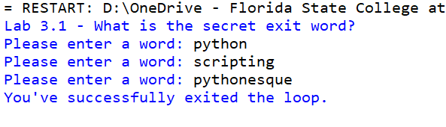
Lab 3.1
Design a program that uses a while loop and continuously asks the user to enter a word unless the user enters the word "pythonesque" as the secret exit word, in which case the message "You've successfully exited the loop." should be printed and the loop should terminate.
Expected output:

Slide 28
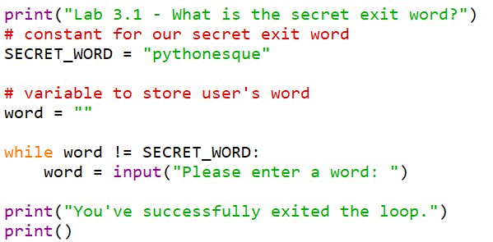
Lab 3.1 Solution

Slide 29

Lab 3.2
Write a program which prints the contents of a string and exits when the letter 'b' is encountered.
Here is the string:
"You're going to need a bigger boat!"
Expected output:

Slide 30
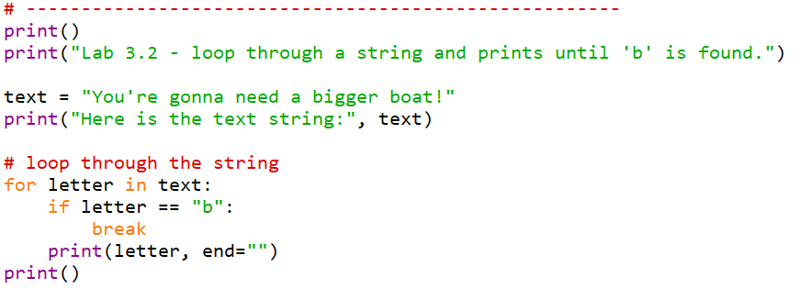
Lab 3.2 Solution

Slide 31
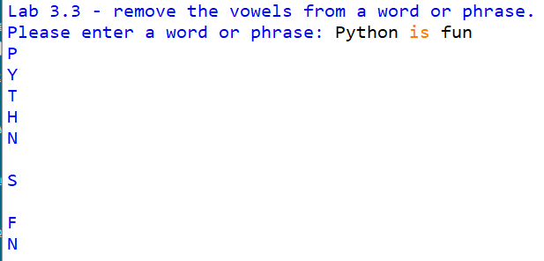
Lab 3.3
Write a program that prompts the user for a word (or sentence).
Loop through the letters in the input and "eat" (ignore) the vowels.
Print the remaining letters, one per line.
Expected output:

Slide 32
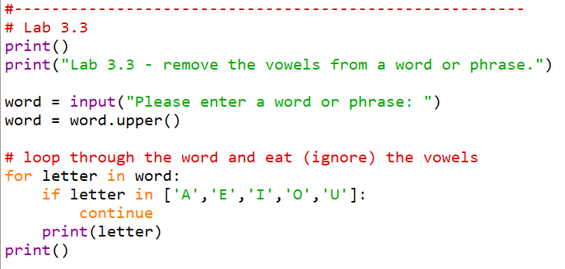
Lab 3.3 Solution

